Slide 1

Jayoti Vidyapeeth women’s university, Jaipur faculty of engineering and technology
Submitted by:-
Jv’n anmol Jangir(jv-u/17/1174)
Jv’n Ayushi Agarwal(jv-u/17/1253)
Jv’n pragati sharma(jv-i/17/1363)

Slide 2
contents
Introduction
How blockchain works
Advantages of blockchain
Educational application using blockchain
Conclusion

Slide 3
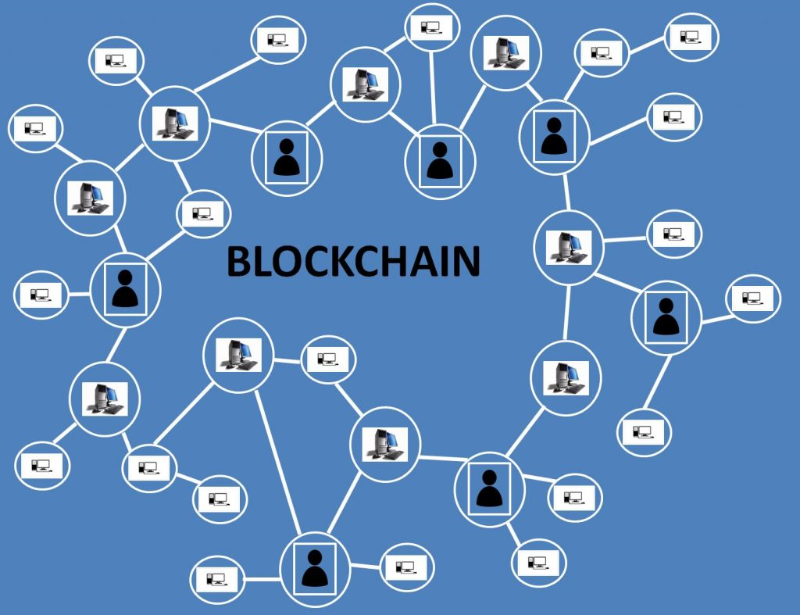

Slide 4
What is Blockchain?
“A system in which a record of transactions made in bitcoin or another cryptocurrency are maintained across several computers that are linked in a peer-to-peer network.”

Slide 5
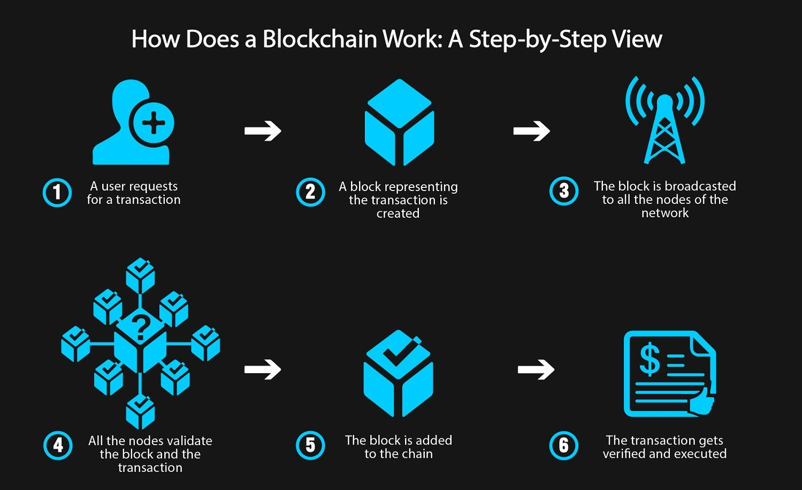

Slide 6
Advantages of blockchain
Transparency
Reduced transaction cost
Faster transaction settlements
Decentralization
User-controlled networks

Slide 7
Educational application using blockchain technology
Disrupting the Current Education Model
Storing Permanent Records
Identity Verification & Information Security
Student Ownership of Learning
Interactive Learning & Analytics
Copyright for Educational Content

Slide 8
conclusion
Blockchain is basically an appropriated record innovation, which utilizes the cryptograph systems and disseminated accord calculations to make the highlights of decentralization, detectability, permanence, and cash properties. It's cash properties can possibly trigger numerous inventive applications for training. For instance, by acknowledging "learning is gaining," blockchain innovation can cultivate understudies' learning inspiration.

Slide 9
THANK YOU

